Slide 1
Semantic Data Modeling and Semantic web Gangmin Li
Data Modelling, Management & Governance CIS108-6
Thanks: Dr Hong Qing Yu

Slide 2
Questions
What is the largest data management system in the world?
What model that system used?
How satisfied are we with that system?

Slide 3
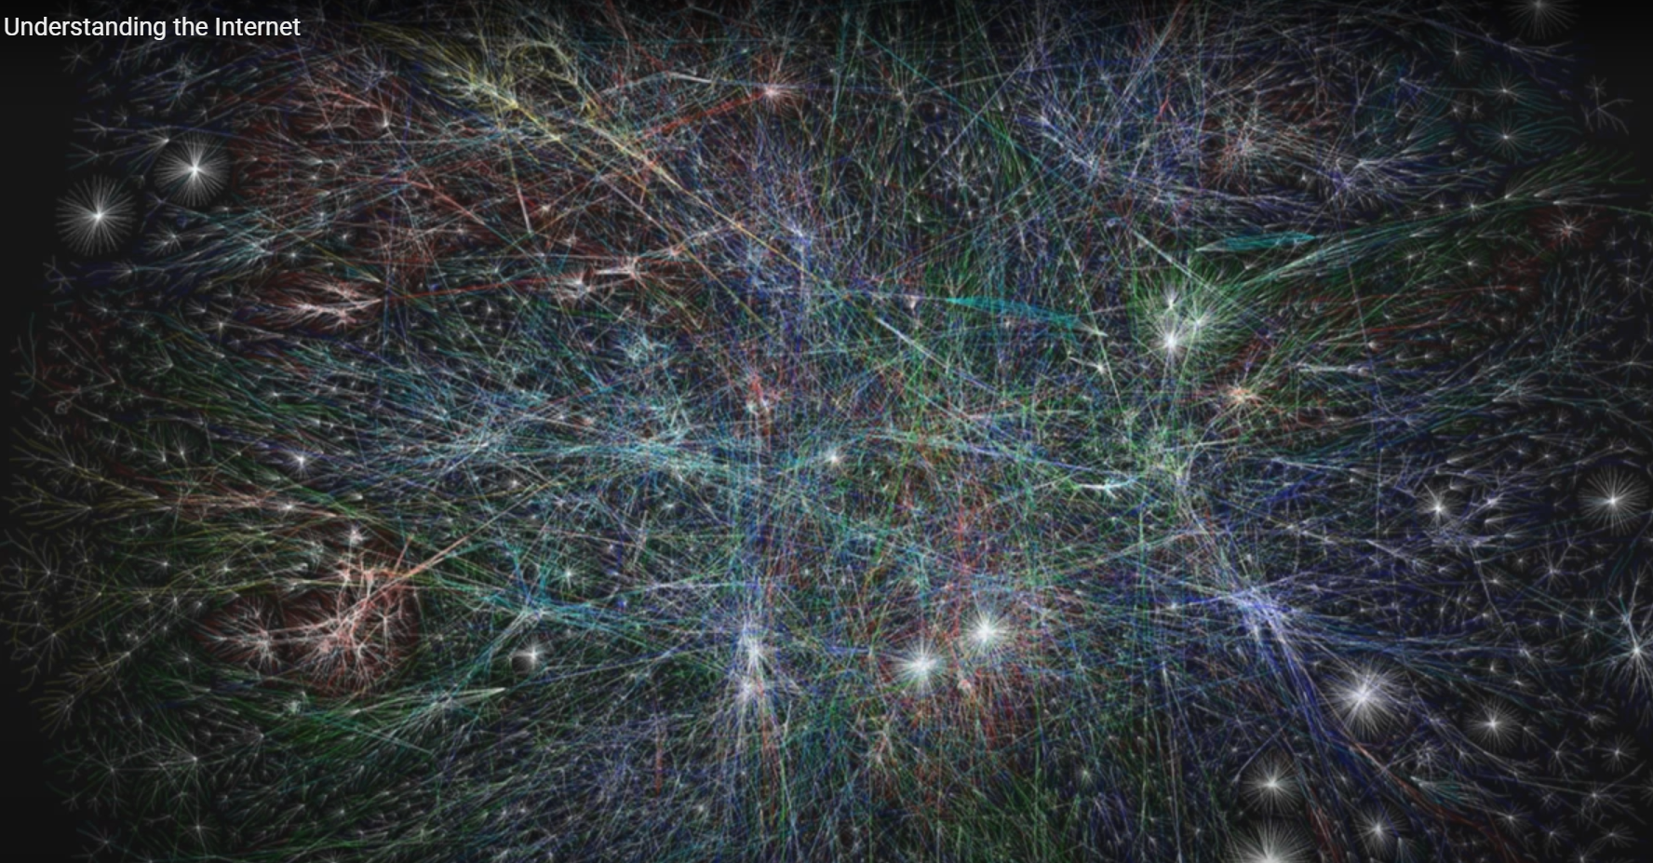
The Internet

Slide 4
The OPTE project
https://www.opte.org/

Slide 5
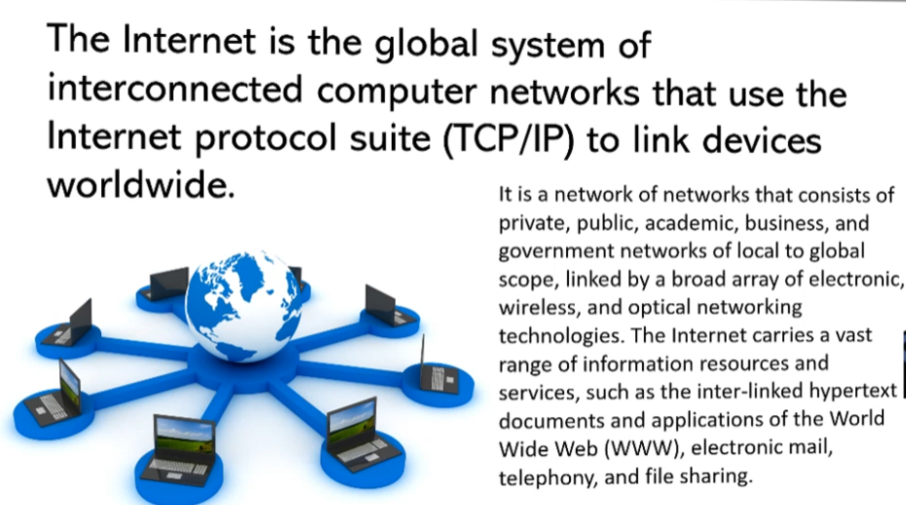
How do we understand the Internet?
Sharing information? (web 1.0/2.0)
Sharing data? (Web3.0)
Sharing knowledge?

Slide 6
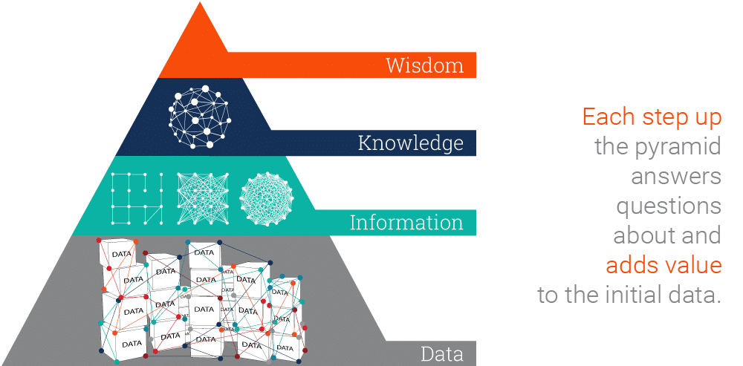
Data, Information, Knowledge, Wisdom (DIKW) Pyramid
The DIKW Pyramid represents the relationships between data, information, knowledge and wisdom..
Share
Share
Share
Share

Slide 7





Fundamental problem with the information sharing
Gap between data sharing and information sharing
Ill-representation: limitations of the media used in information sharing and transferring that the meaning of the data has been wrongly interpreted.
Fruit: taste, colour, shape, size, etc
Apple
Places: Apple orchard, Apple street, Apple theatre,
Movies, Magazine, etc

Slide 8
How we solve this problem?
Data Semantic modelling
Semantic data model (SDM) is a high-level semantics-based database description and structuring formalism (database model) for databases.
An SDM specification describes a database in terms of the kinds of entities that exist in the application environment, the classifications and groupings of those entities, and the structural interconnections among them.
SDM provides a collection of high-level modelling primitives to capture the semantics of an application environment. By accommodating derived information in a database structural specification,

Slide 9
What is Semantic Modeling?
A semantic data model has two basic meanings:
It is a conceptual data model in which semantic information is included. This means that the model describes the meaning of its instances. (Object-oriented backed up by a fix ontology)
It is a conceptual data model that includes the capability to express information that enables parties to the information exchange to interpret meaning (semantics) from the instances, without the need to know the meta-model. (fact-oriented, sometimes needs annotation, tags)
Typically binary relations have the form of triples:
Object - RelationType - Object
For example: the Eiffel Tower <is located in> Paris.
Notes:
Typically the instance data of semantic data models explicitly include the kinds of relationships between the various data elements, such as <is located in>. To interpret the meaning of the facts from the instances, it is required that the meaning of the kinds of relations (relation types) be known. Therefore, semantic data models typically standardize such relation types. This means that the second kind of semantic data models enables that the instances express facts that include their own meanings. The second kind of semantic data models are usually meant to create semantic databases. The ability to include meaning in semantic databases facilitates building distributed databases that enable applications to interpret the meaning from the content. This implies that semantic databases can be integrated when they use the same (standard) relation types. This also implies that in general they have a wider applicability than relational or object-oriented databases.
https://www.wikiwand.com/en/Semantic_data_model

Slide 10
Outline
Introduction of Semantic Web/Linked Data based semantic data modeling
Basic concepts
Graph database
RDF
Semantic Ontological Modeling
Ontology
Create Ontology

Slide 11
Basic Concepts
Semantic Data Modelling

Slide 12
Basic concept
Semantic Web/Linked Data
https://www.youtube.com/watch?v=V6BR9DrmUQA
Principally, the Semantic Web is a Web 3.0 web technology - a way of linking data between systems or entities that allows for rich, self-describing interrelations of data available across the globe on the web.
Only Human Readable
(1.0)
Human Intractable
(2.0)
Machine Readable and Intractable
(3.0)

Slide 13
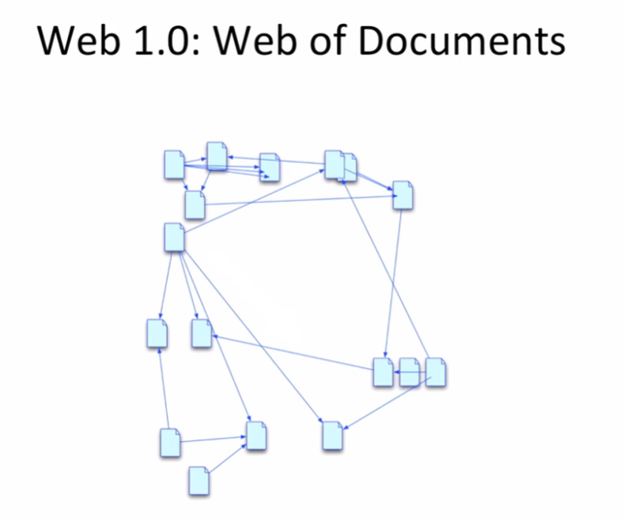
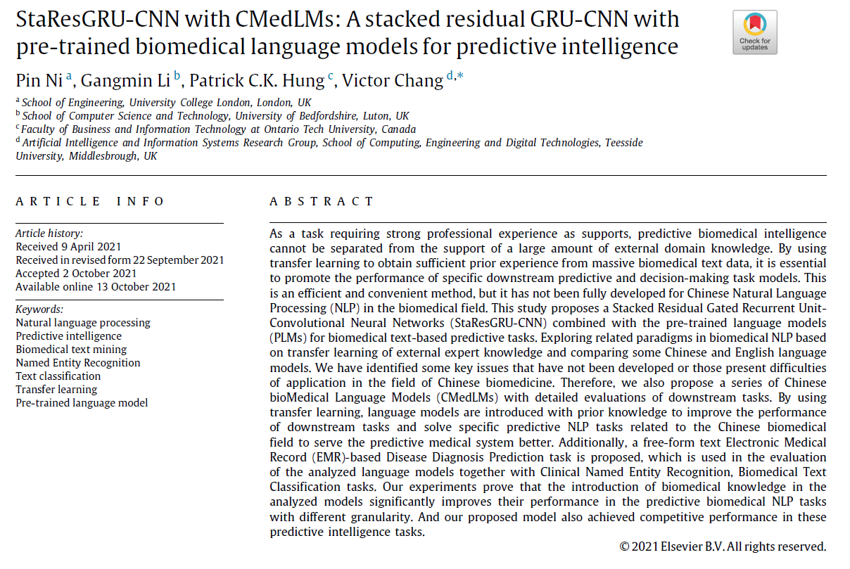
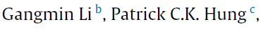
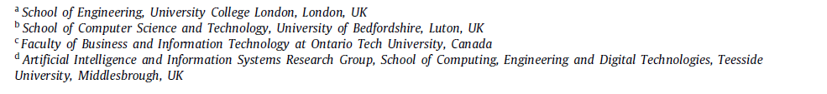
References: Connecting documents

Slide 14
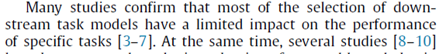
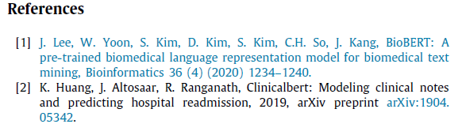
References

Slide 15
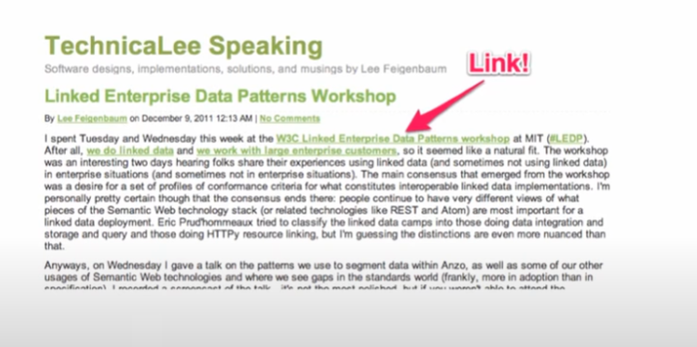
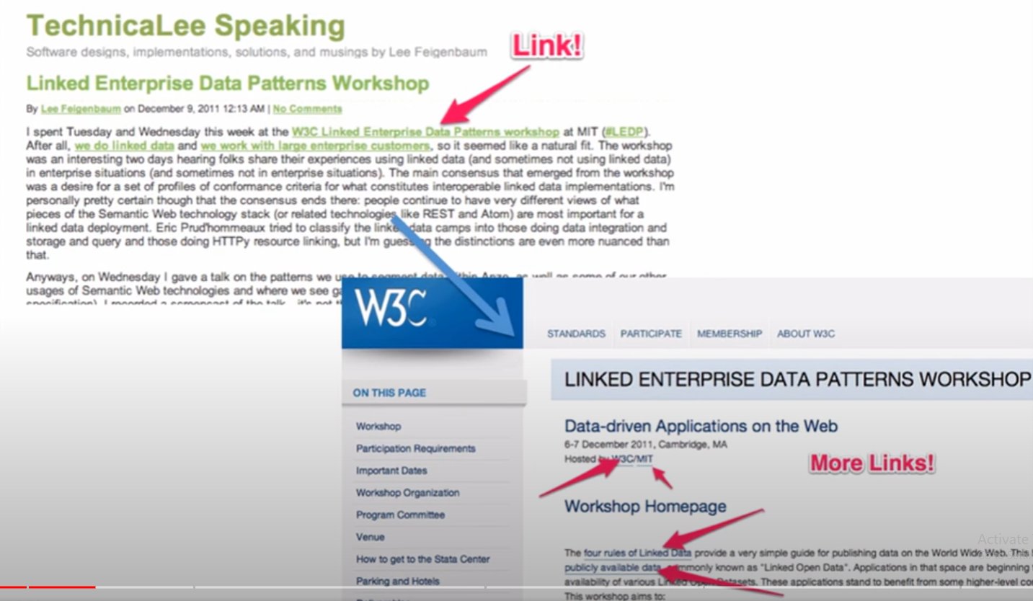
Hyperlink (Hypertext)- Web1.0

Slide 16
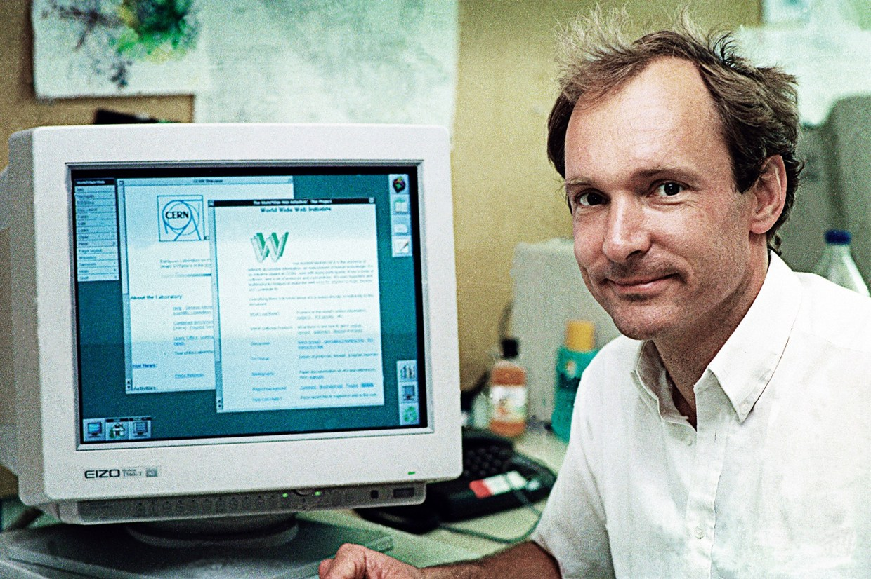
Who proposed the idea?
Sir Timothy John Berners-Lee OM KBE FRS FREng FRSA FBCS (born 8 June 1955), also known as TimBL, is an English engineer and computer scientist, best known as the inventor of the World Wide Web. He is currently a professor of computer science at the University of Oxford and the Massachusetts Institute of Technology (MIT). He made a proposal for an information management system in March 1989, and he implemented the first successful communication between a Hypertext Transfer Protocol (HTTP) client and server via the internet in mid-November the same year.
Web 1.0
Sir Tim Berners-Lee

Slide 17
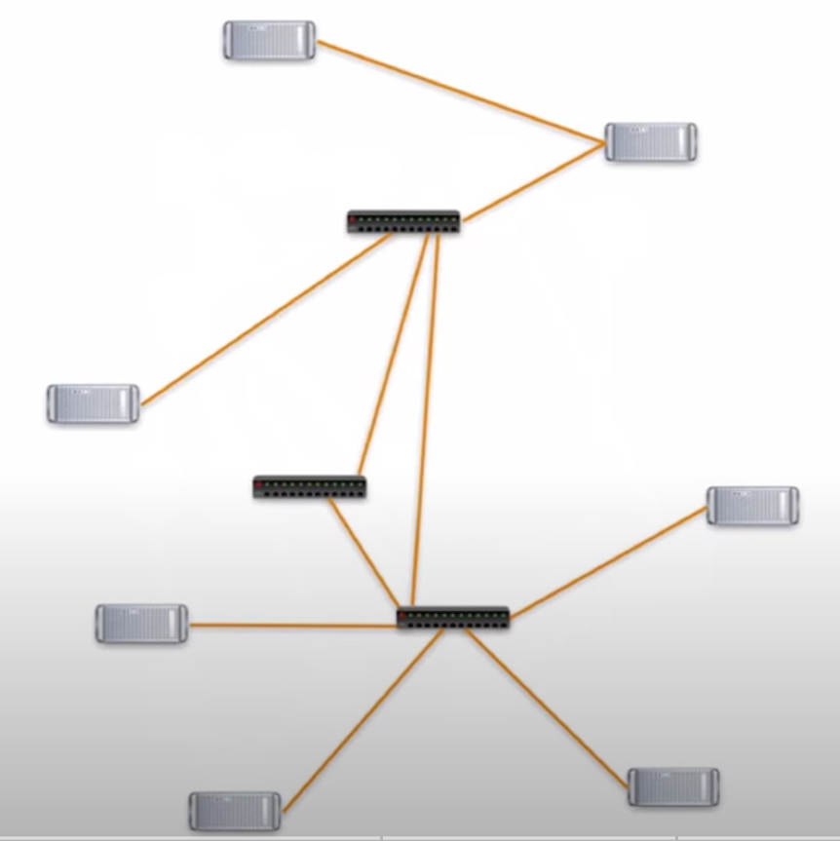

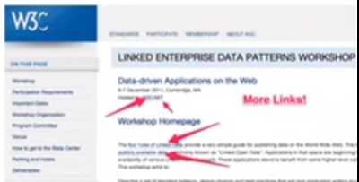
Web 1.0: under the hood

Slide 18
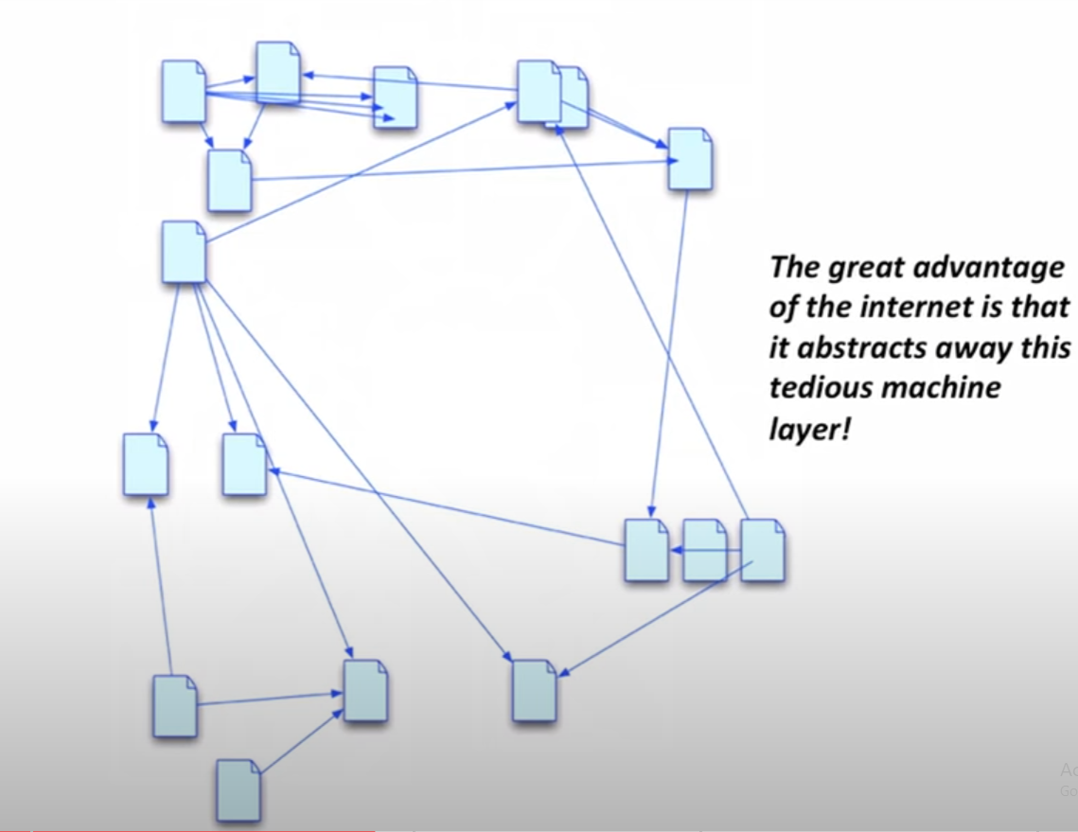
URI: web address

Slide 19
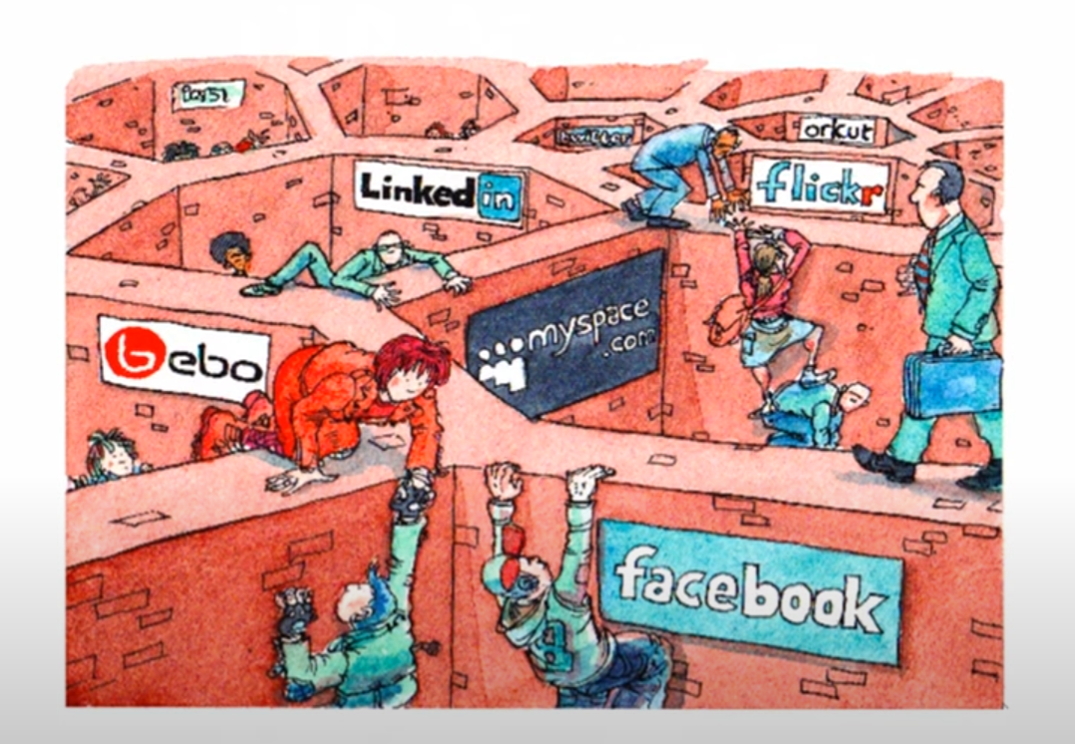
Web 2.0: Info Services-Applications
Silos
No sharing
Update from one system is no effect on other systems

Slide 20
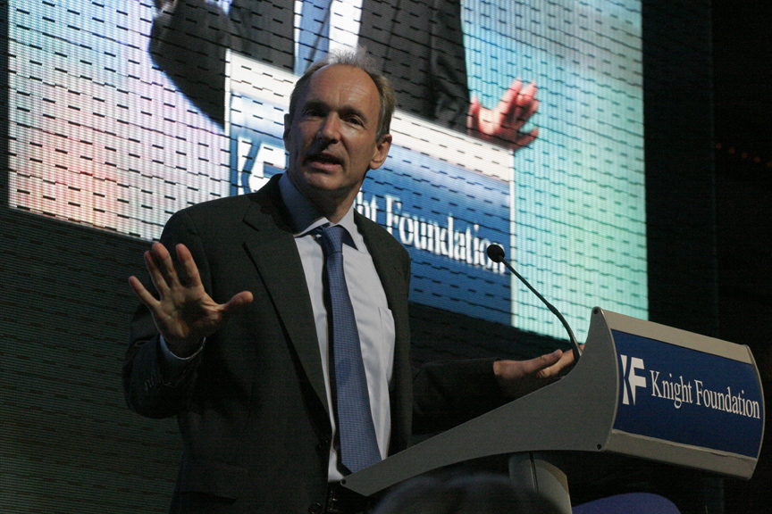
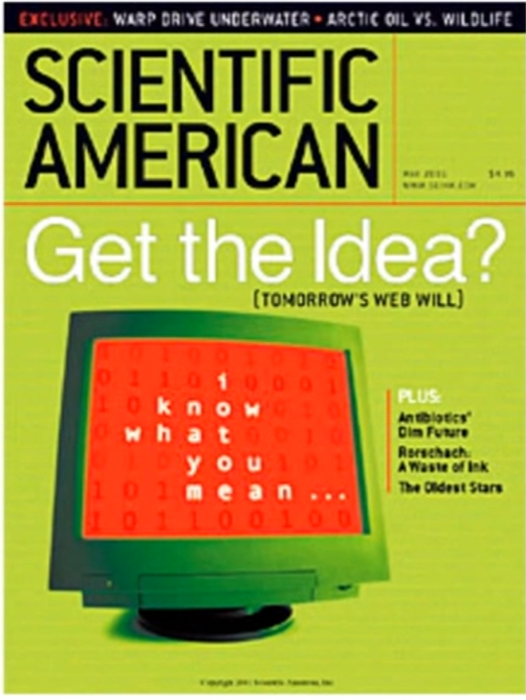
Born of Semantic Web: Web:3.0
The 2001 Scientific American article by Berners-Lee, Hendler, and Lassila described an expected evolution of the existing Web to a Semantic Web. In 2006, Berners-Lee and colleagues stated that: "This simple idea…remains largely unrealized”. However, more than four million Web domains contained Semantic Web markup In 2013.
https://www.youtube.com/watch?v=OM6XIICm_qo

Slide 21
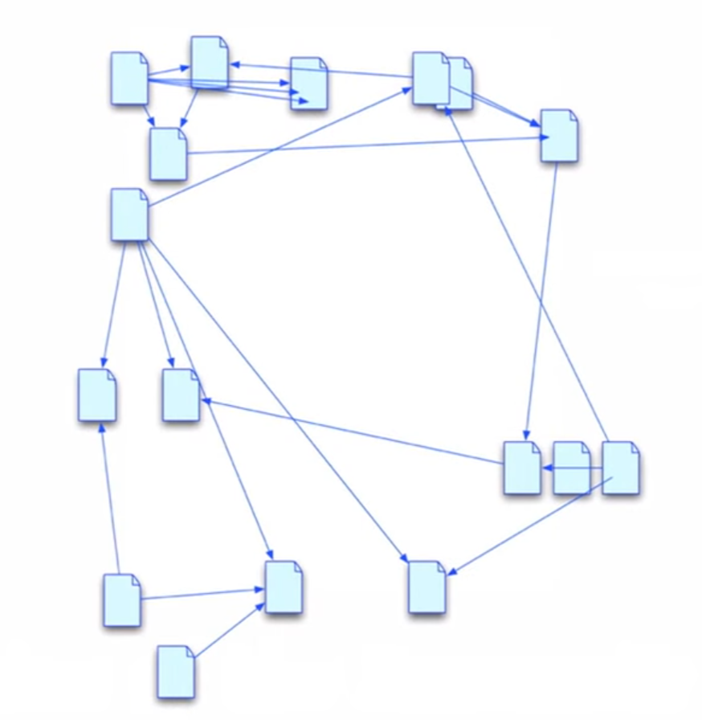
Basic concept: Connect Data
All three places have information about Evan Sandhaus
Facebook
LinkedIn
ResearchGate

Slide 22
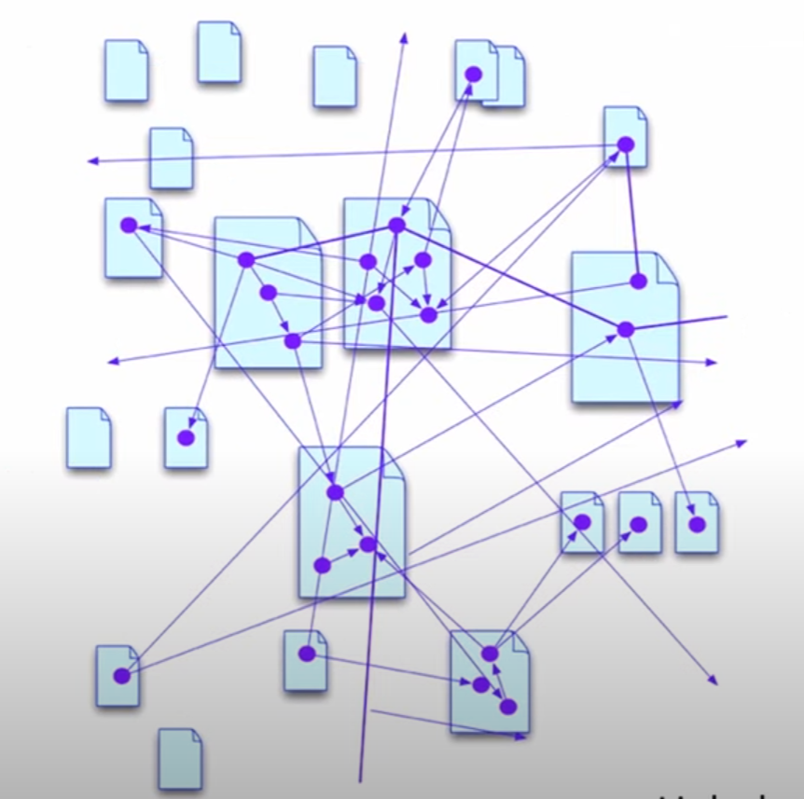
Connecting Silos: Building the Data Web
Instead of Links between documents
Links between facts!

Slide 23
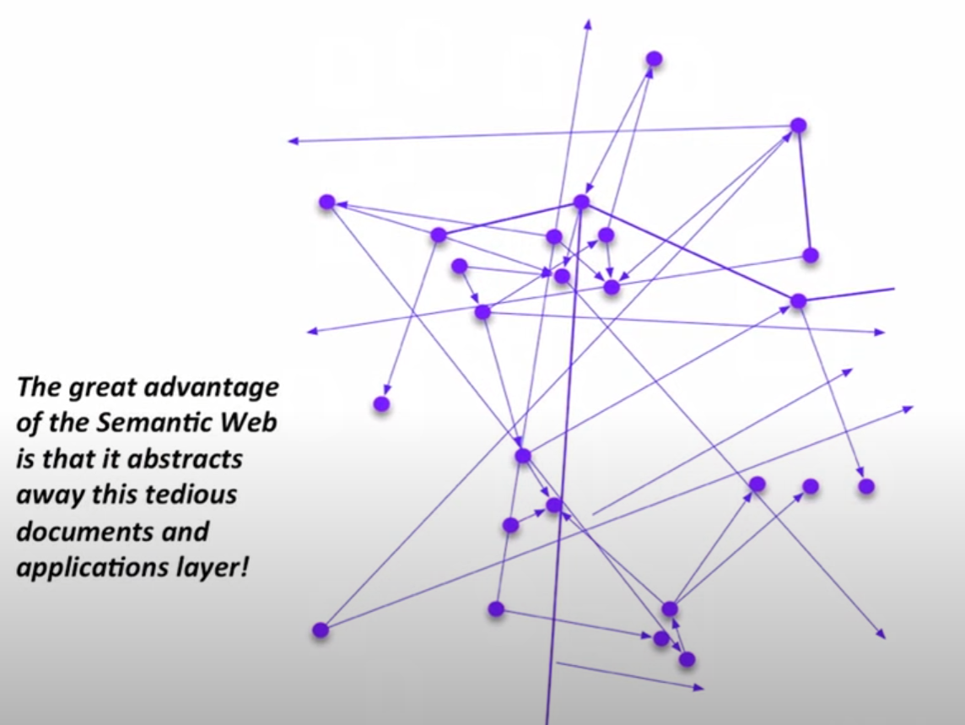
Connecting Silos: Building the Data Web
HTML (Web 1.0):
Hide machine connections from information
Semantic web (Web 3.0):
Hide the documents connections and focus on data and facts

Slide 24
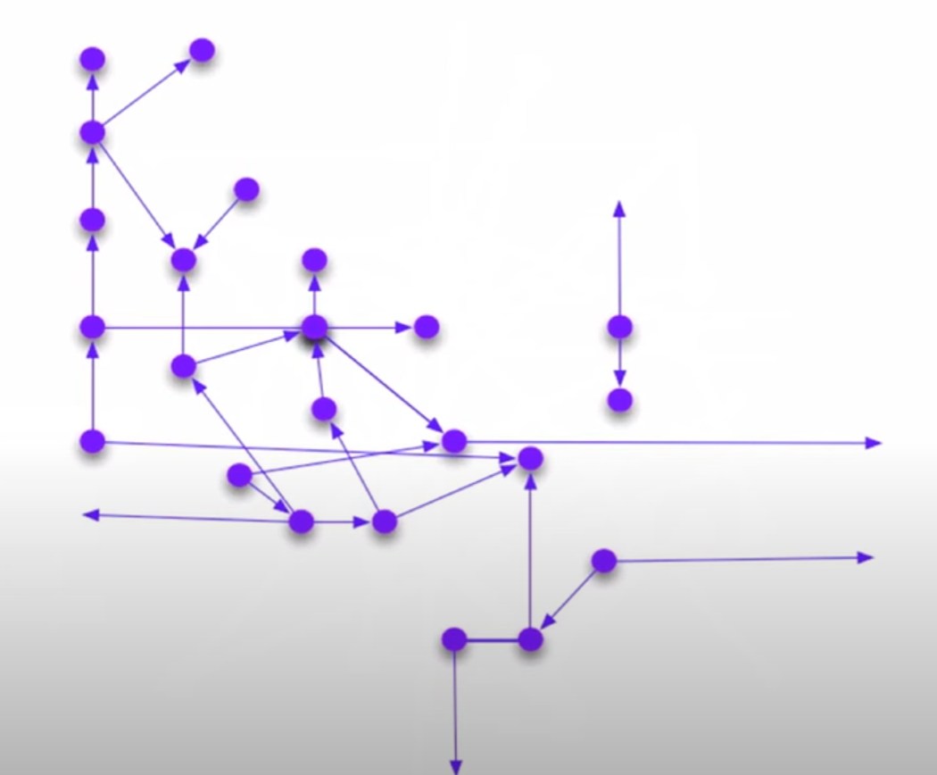
Connecting Silos: Building the Data Web

Slide 25
Aims of Semantic Web
Eliminate the misinformation (ill-representation), by,
Opening up the web of data
Encouraging companies, organisations and individuals to publish their data freely, in an open standard format.
Encouraging businesses to use data already available on the web (data give/take).

Slide 26
Benefits
In essence, taking all that information source (data and basic facts) published in HTML documents in different places, and the description of models of data (meaning) that allow data to be treated - and researched - as if it were one database.
Open up the access to the web of data allows data analytics. Machine learning and AI to be advanced.
The benefits to the automated information/knowledge search of all the data humanity has to offer available on the internet.

Slide 27
Introduction to Graph Data Model
Semantic Data Modelling: data is modelled as a graph

Slide 28
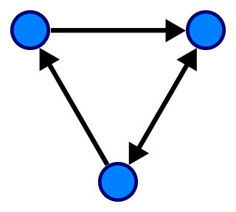
Graph Data
A graph data structure consists of a finite (and possibly mutable) set of vertices (also called nodes or points), together with a set of unordered pairs of these vertices for an undirected graph or a set of ordered pairs for a directed graph. These pairs are known as edges (also called links or lines), and for a directed graph are also known as edges but also sometimes arrows or arcs.
A directed graph with three vertices (blue circles) and three edges (black arrows).

Slide 29
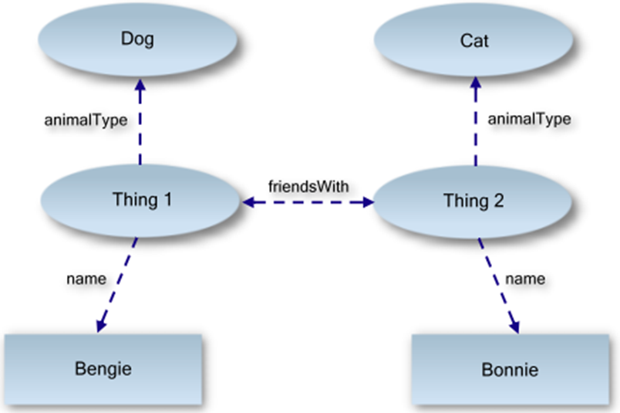
An Example Of A Data Graph
Bengie is a dog. Bonnie is a cat. Bengie and Bonnie are friends.

Slide 30

Graph Presentation
The relationships implied by this graph are fairly intuitive:
We can can see that our two things - identified by "Thing 1" and "Thing 2" - have the properties name, animalType and friendsWith.
From this, we can see that
"Thing 1"'s name is Bengie, and
"Thing 2"'s name is Bonnie.
"Thing 1" is a dog, and
"Thing 2" is a cat.
And finally, both are friends with each other (implied by the friendsWith property pointing in both directions).
Important Point The arrows in the above diagram are properties, and that it is the arrows that describe the properties in the graph.

Slide 31
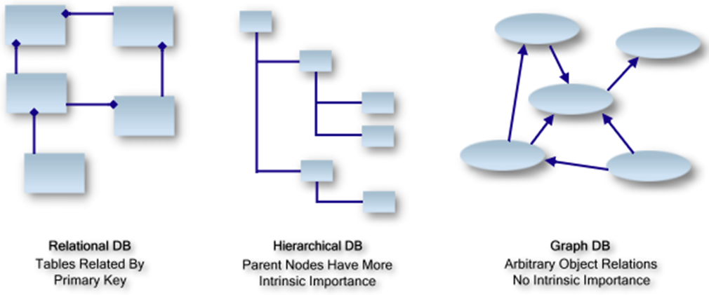
Database as Graph Data

Slide 32
Introducing RDF/XML
Semantic Data Modelling: graph based data models

Slide 33
What is RDF?
The Resource Description Framework (RDF) is a family of World Wide Web Consortium (W3C) specifications originally designed as a metadata data model.
It is used as a general method for conceptual description or modelling of information that is implemented in web resources with URIs.
RDF use URIs to name the relationship between things as well as the two ends of the link (this is usually referred to as a “triple”).
RDF databases is also called Triple Store

Slide 34
An Example Of RDF
Subject
Predict
Object
Everything is a triple
predict
Subject
Object

Slide 35
URIs, URL And XML Namespaces
What is URIs?
A Uniform Resource Identifier (URI) is a unique sequence of characters that identifies a logical or physical resource used by web technologies. URIs may be used to identify anything, including real-world objects, such as people and places, concepts, or information resources such as web pages and books.
What is URLs
Some URIs provide a means of locating and retrieving information resources on a network (either on the Internet or on another private network, such as a computer filesystem or an Intranet); these are Uniform Resource Locators (URLs).
A URL provides the location of the resource. A URI identifies the resource by name at the specified location or URL.
Example: http://www.beds.ac.uk

Slide 36
XML Namespace URIs
What is the purpose of namespace?
Namespace is a declarative region that provides a scope to the identifiers (the names of types, functions, variables, etc) inside it.
A namespace ensures that all of a given set of objects have unique names so that they can be easily identified.

Slide 37
RDF Root Tag
If you look at line 2, you will see the standard W3.org namespace http://www.w3.org/1999/02/22-rdf-syntax-ns#.
This namespace tells any machine reader that the enclosing document is an RDF document, and that the rdf:RDF tag resides in this namespace.
This namespace, and the RDF node, forms the root of all RDF documents.

Slide 38
Add A Statement
The rdf:Description tag simply means "I'm going to describe something (a subject) and I'm giving it the unique ID http://www.linkeddatatools.com/clothes#t-shirt".

Slide 39
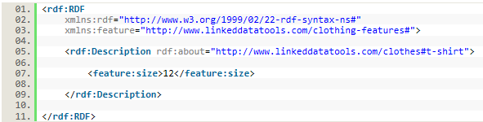
Add Predicates
See line 07. This simply says "The subject has a property with name feature:size which has the literal value 12". In RDF terminology, this is a statement.

Slide 40
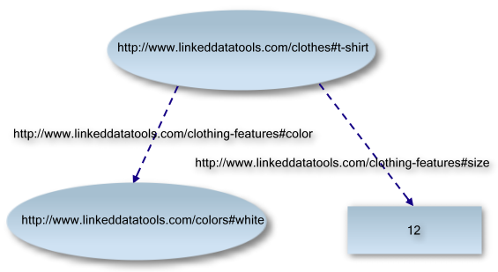
Add Predicates

Slide 41
Breaking Down The Statement
Here you see the subject of the statement (what the statement is about), and the two forms of predicates (literal values and resources, which reference other RDF statements).
subject
predicate 1
predicate 2
“literal value”
object

Slide 42
A More Complete Example
To test your understanding and point out any areas where you need to recap, see if you can identify on the RDF document above the:
Subject of the statement
Predicates of the statement - including whether they are resources or literals
Objects referenced by the resource predicates

Slide 43
Semantic Ontological Modelling
Semantic Data Modelling

Slide 44
What is an Ontology?
Ontology is the study or concern about what kinds of things exist - what entities or `things' there are in the universe[3].
In computer science, an ontology is the working model of entities and interactions either generically [4] or in some particular domain of knowledge or practice[5].
An ontology is `the specification of conceptualisations, used to help programs and humans share knowledge' [6].

Slide 45
Ontology Modeling
An ontology defines a common vocabulary for sharing information in a specific domain. It includes machine-interpretable definitions of basic concepts in the domain and relations among them.

Slide 46
Why do we need Ontology?
To share common understanding of the structure of information among people or software agents
To enable reuse of domain knowledge
To make domain assumptions explicit
To separate domain knowledge from the operational knowledge
To analyze domain knowledge

Slide 47
Main Components of an Ontology
There are 4 components of an ontology: concepts, slots, relations, instances and axioms.
Concepts(classes): A concept represents a set or class of entities or `things' within a domain.
Concepts (classes) are usually organized in taxonomies
Examples: Protein is a concept within the domain of molecular biology. Biology is a sub-class of Science.
In univ-ontology: student and professor are two Classes

Slide 48
Main components of an Ontology
Relations: Relations describe the interactions between concepts or a concept's properties.
Relations also fall into two broad kinds
Taxonomies that organise concepts into sub- super-concept tree structures. The most common forms of these are
Specialisation relationships commonly known as the `is a kind of' relationship
Partitive relationships describe concepts that are “part of” other concepts
Associative relationships that relate concepts across tree structures. Commonly found examples include the following:
Nominative relationships describe the names of concepts - Protein hasAccessionNumber AccessionNumber
Locative relationships describe the location of one concept with respect to another
Associative relationships that represent, for example, the functions, processes a concept has or is involved in, and other properties of the concept - Protein hasFunction Receptor, Protein isAssociatedWithProcess Transcription and Protein hasOrganismClassification Species.
Many other types of relationships exist, such as `causative' relationships,

Slide 49
Main components of an Ontology
Axioms: axioms are used to constrain values for classes or instances.
Model sentences that are always true
Example: if the student attends both A and B course, then he or she must be a second year student
Instances: Instances are the `things' represented by a concept
Instances represent specific elements
Example: Student called Peter is the instance of Student class
Strictly speaking, an ontology should not contain any instances, because it is supposed to be a conceptualisation of the domain. The combination of an ontology with associated instances is what is known as a knowledge base.

Slide 50
6 Steps To Build Ontology
Semantic Data Modelling

Slide 51
Step 1: Determine the Domain and Scope
Domain and Scope of the ontology
– what is the domain that the ontology will cover?
– for what we are going to use the ontology
– for what types of questions the information in the ontology should provide answers
– who will use and maintain the ontology
• Example: Food Ontology

Slide 52
Step 2: Reuse existing ontologies
Consider reusing existing ontologies
For example, food ontology
ProductOrService related ontology e.g. GoodRelations

Slide 53
Step 3: List important terms
Enumerate important terms in the ontology
– A list of terms which are important to explain to the user
– What properties do those terms have?
– What would you like to say about those terms
• Important: to get the comprehensive list of terms

Slide 54
Step 4: Define the classes and the class hierarchy
– Top-down
• starts with the most general concepts
• subsequent specialization of the concepts
– Bottom-up
• starts with the most specific concepts or classes, the leaves of the hierarchy
• subsequent grouping of these classes into more general concepts
– Middle-out
• combination of the top-down and bottom-up approaches
• starts wit the salient concepts first
• generalize and specialize them appropriately
– Subclass relation
• if class B represents a concept that is a “kind of” A, then B is subclass of A

Slide 55
Step 5: Define the properties of classes
– Define the internal structure of concepts - slots
– Several types of properties that can become slots in an ontology
• intrinsic properties: flavour of a wine
• extrinsic properties: a wine’s name
• parts: physical and abstract “parts” (e.g, the courses of a
meal)
• relationships to other individuals (e.g. the maker of the wine)
– All subclasses of a class inherit the slot of that class.

Slide 56
Step 6: Define the facets of the slots
– value type,
– allowed values,
– the number of the values (cardinality)

Slide 57
Food Ontology Example

Slide 58
Summary
Semantic web is a technology to utilise Data’s semantic modelling
Data semantic modelling is to ensure the common understand of the data (eliminate the wring interpretation of the data)
To enable Web “Data Connections” (web 3.0)
Sematic web uses graph and ontology

Slide 59
Exercise and questions
How to write your own basic RDF documents in RDF/XML
Understand how and why RDF uses URIs to identify subjects, predicates and objects
How to relate an RDF document to a corresponding data graph with fully qualified URIs

